Slide 1
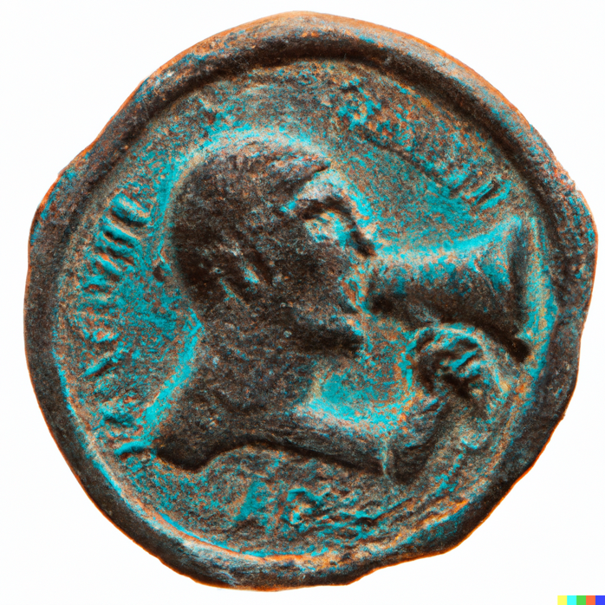
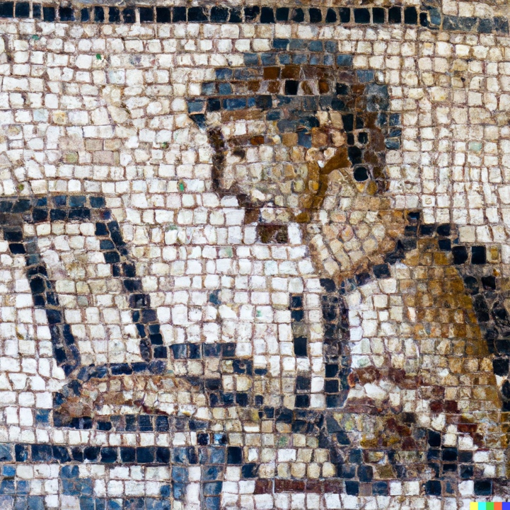
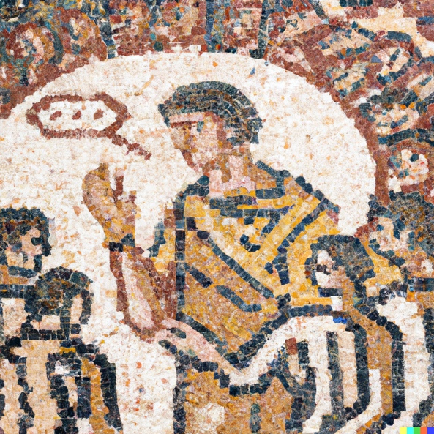
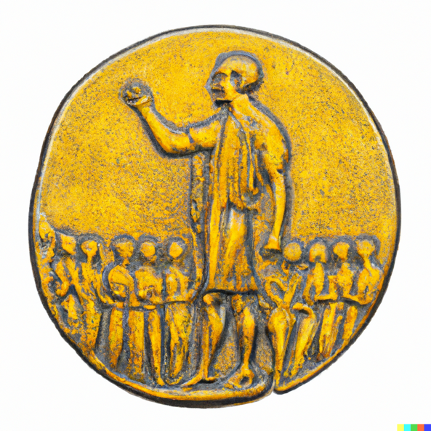
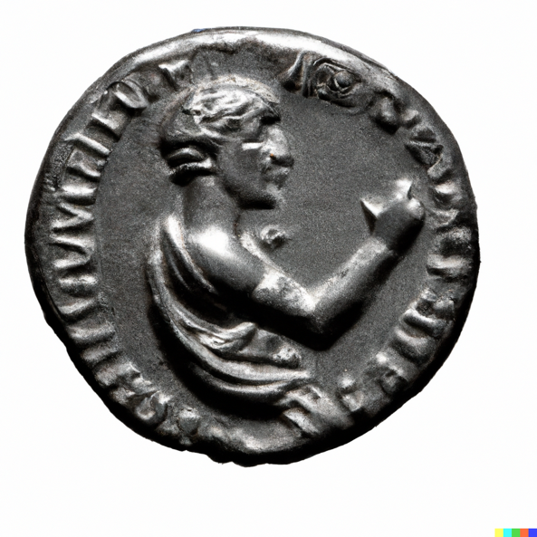
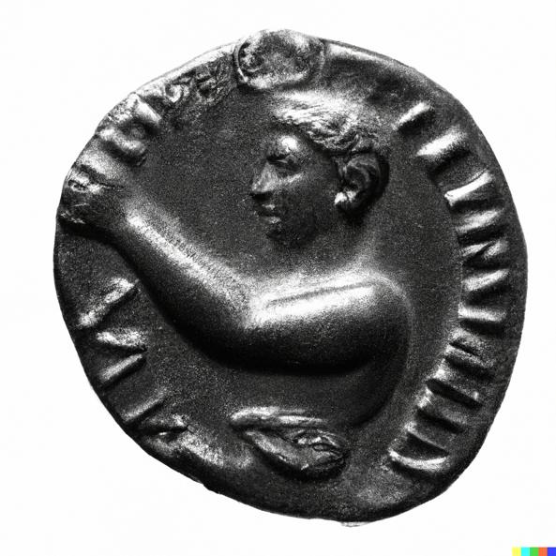
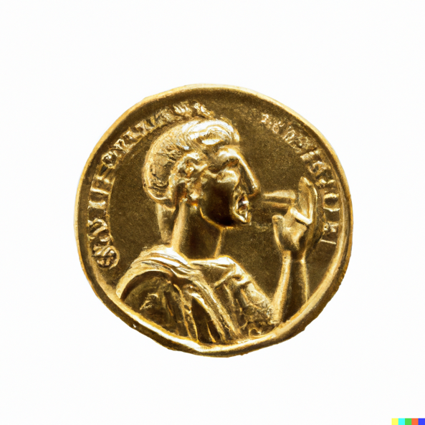
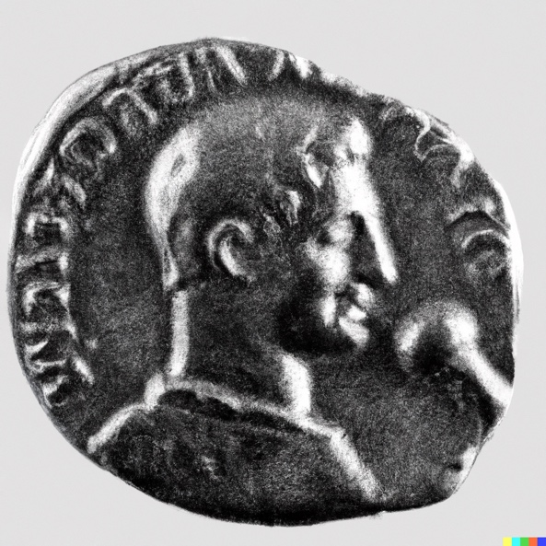
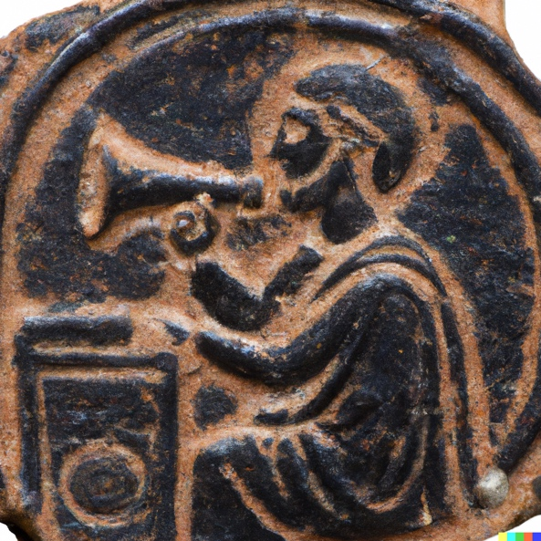
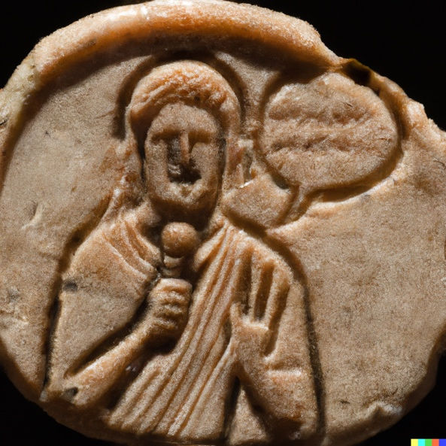
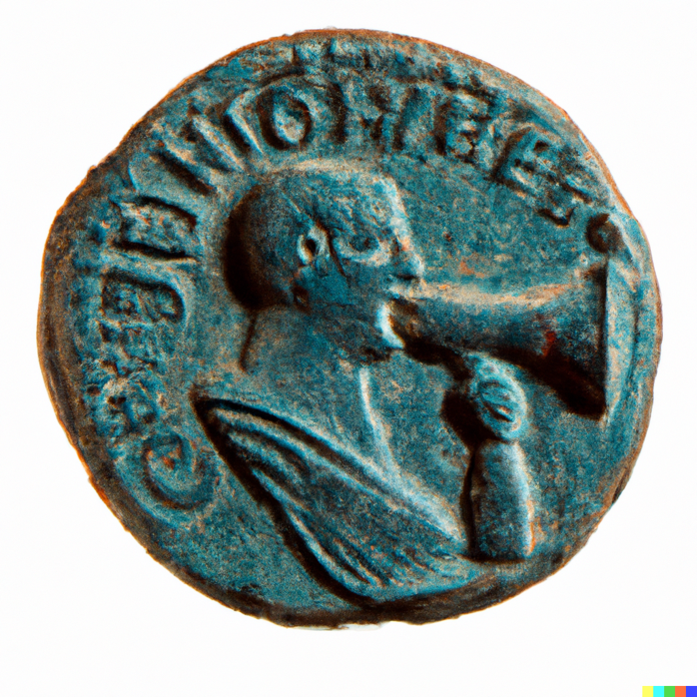
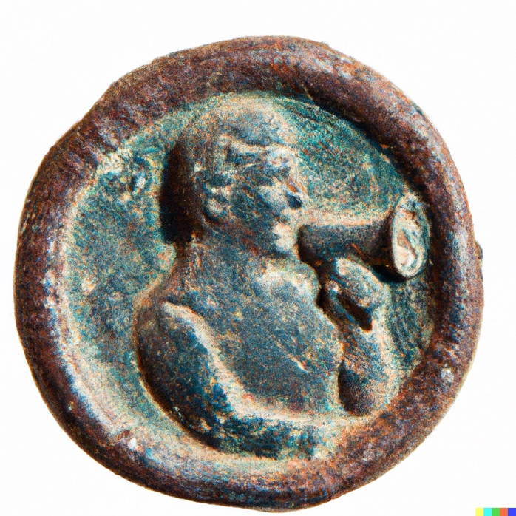
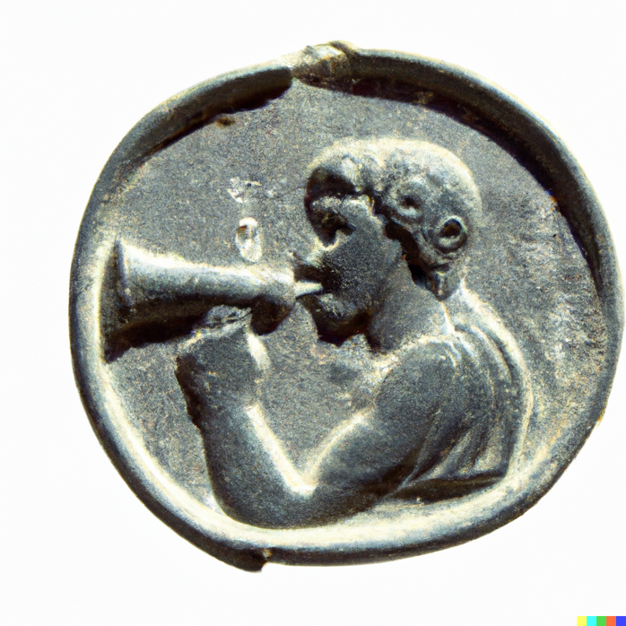
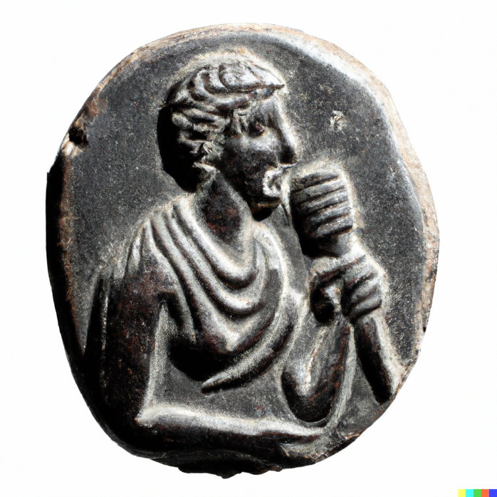

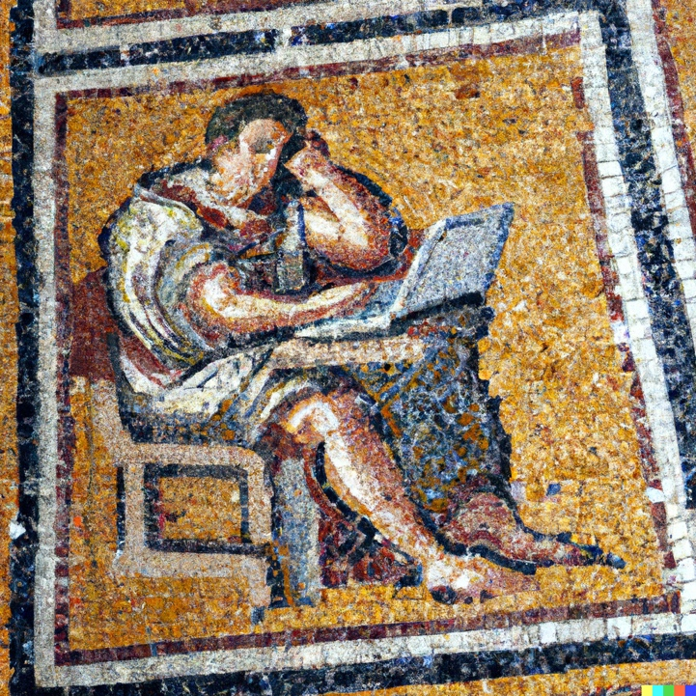
Dall-e created images using various prompts

Slide 2
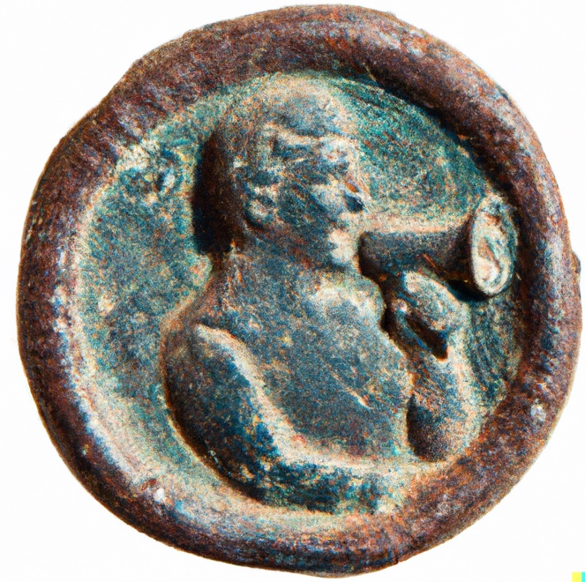
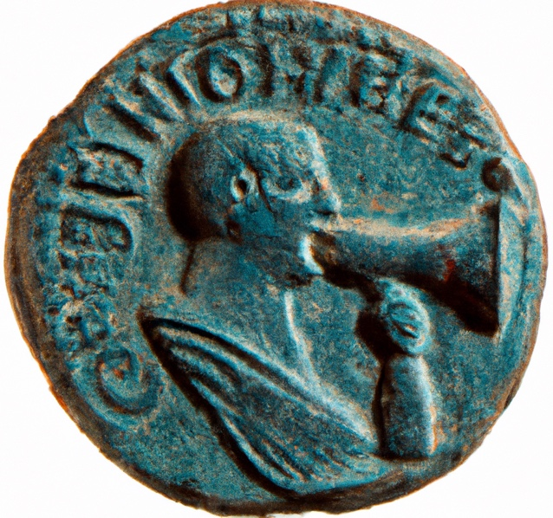
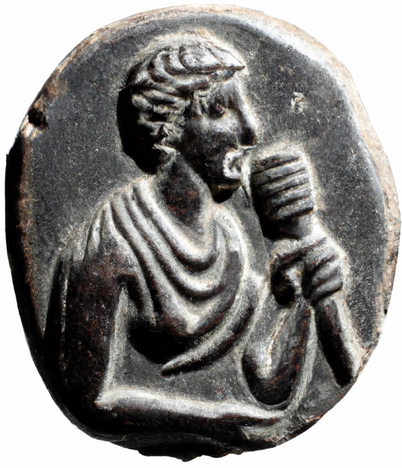
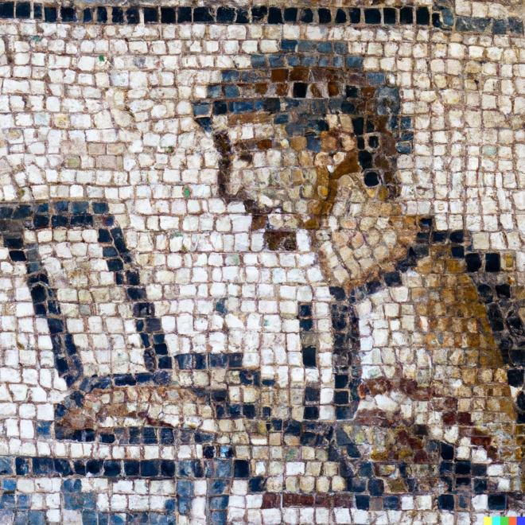
”Say What?” Searching for Cultural Conformity and Diversity Using Byzantine Seals
Paul Albert
George Mason University
Dumbarton Oaks
International Congress on Medieval Studies, May 11, 2023

Slide 3
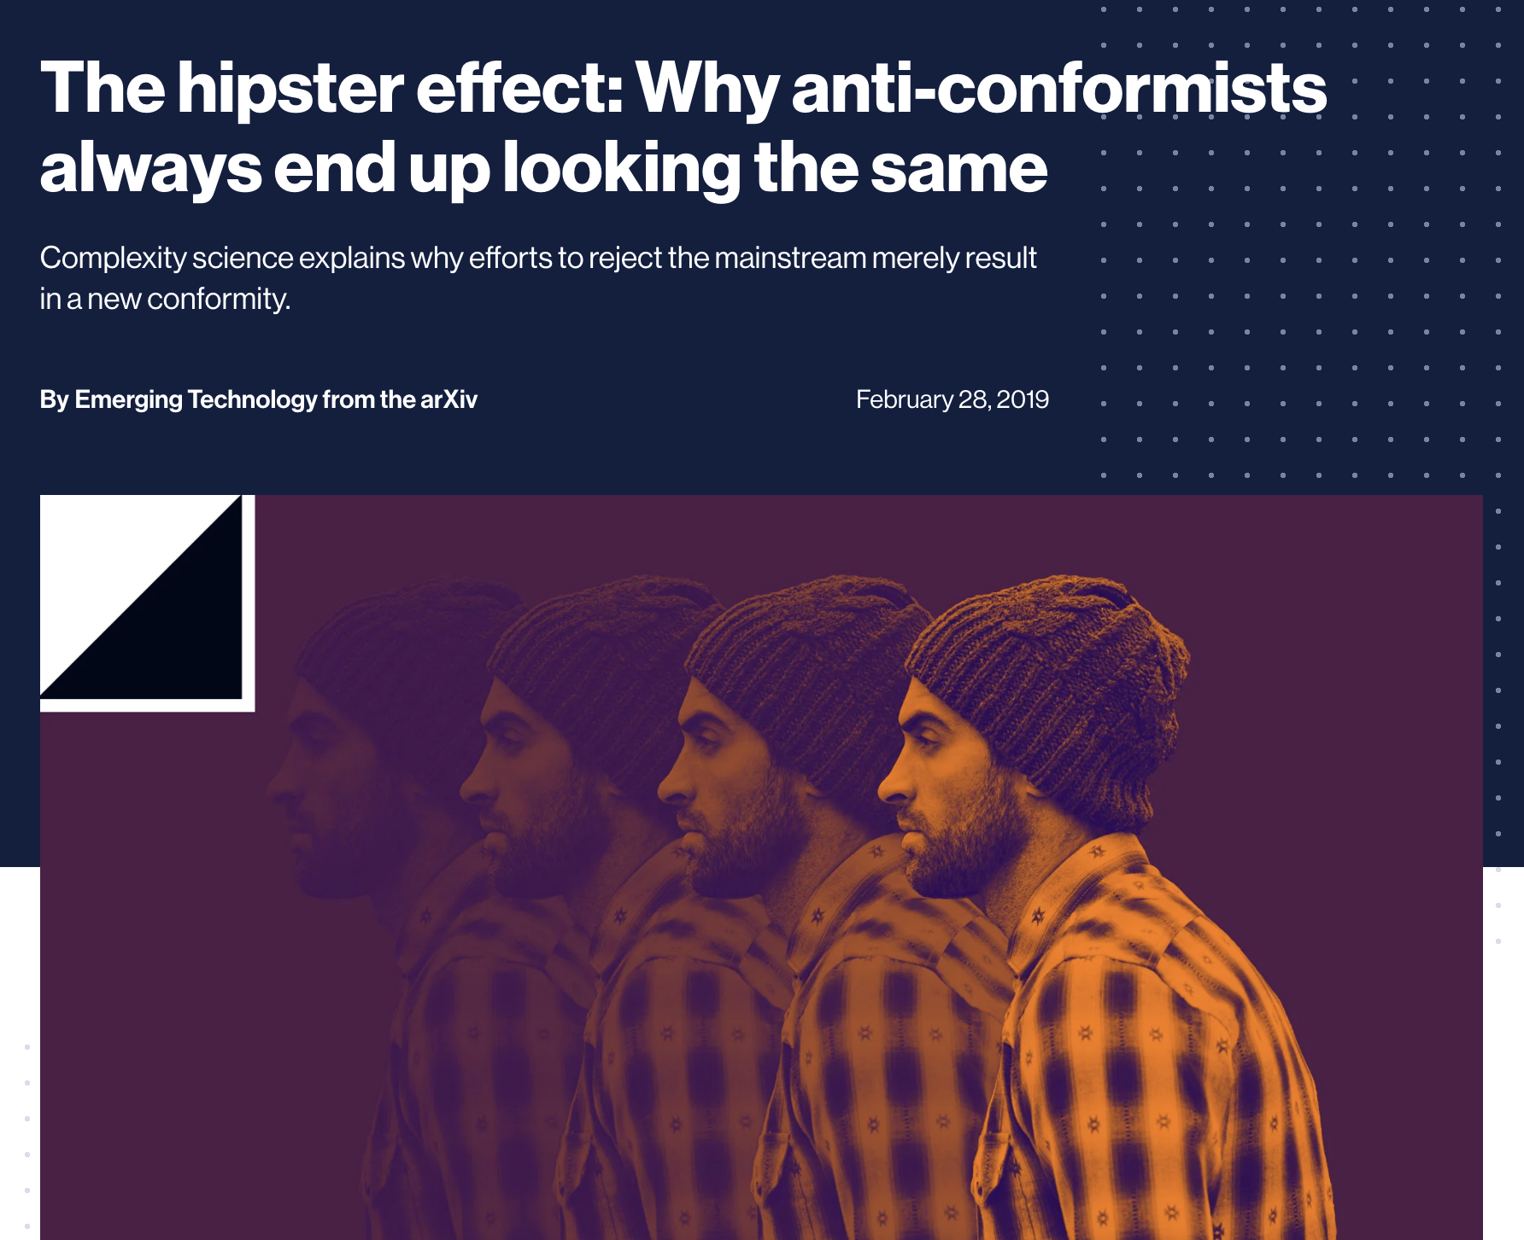
“The squeaky wheel gets the oil”
“The nail that sticks out gets hammered down”
“The higher the tree, the stronger the wind”
Source: The MIT Technology Review, February 28, 2019

Slide 4
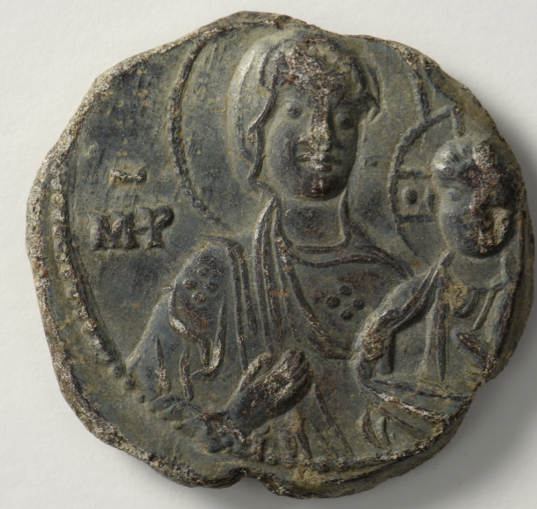
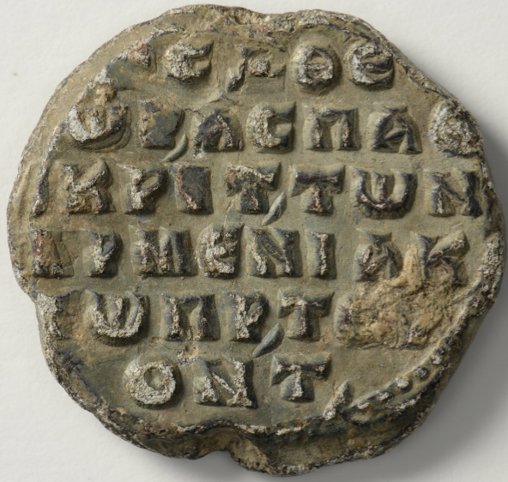
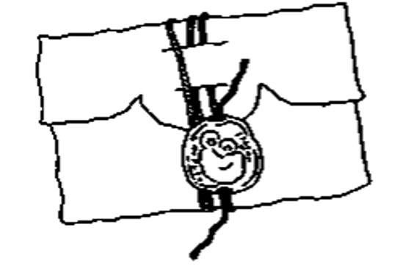
Obverse Description
Bust of the Virgin holding the Christ child on her left arm. Sigla. Border of dots.
Reverse Description
Inscription of seven lines. Border of dots.
Inscription Text
Θεοτόκε βοήθει τῷ σῷ δούλῳ Θεοδώρῳ πρωτοσπαθαρίῳ καὶ κριτῇ τῶν Ἀρμενιακῶν τῷ Πρωτεύοντι.
Mother of God, help your servant Theodore Proteuon, protospatharios and judge of the Armeniakoi.
https://www.doaks.org/resources/seals/byzantine-seals/BZS.1951.31.5.495/view

Slide 5
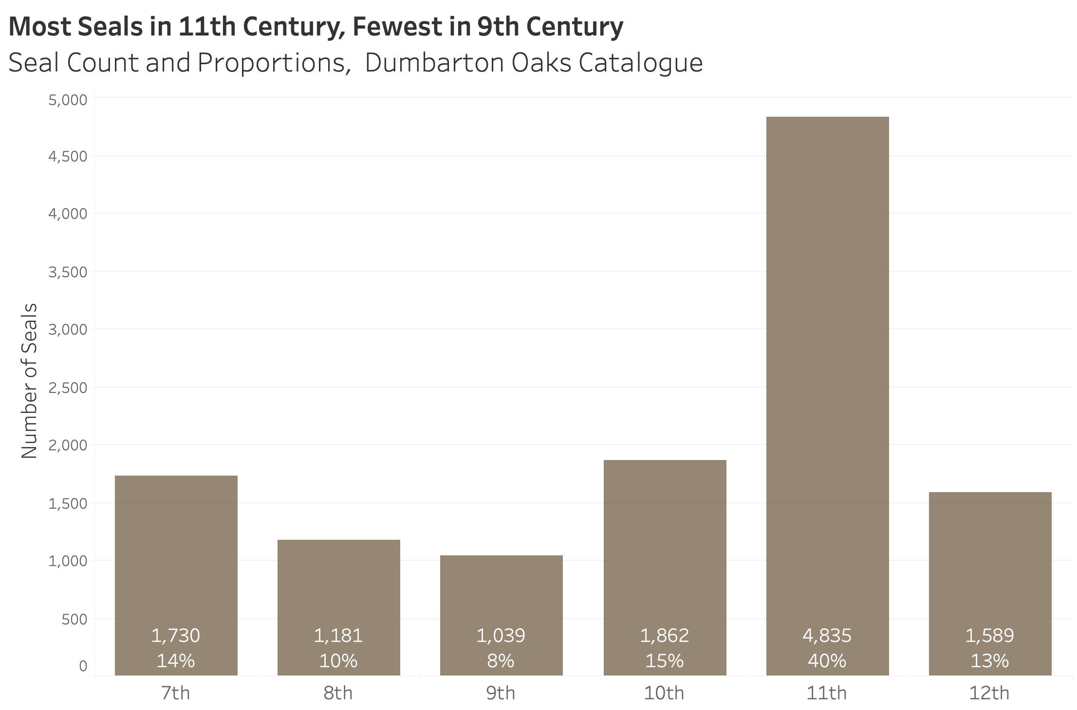

Slide 6
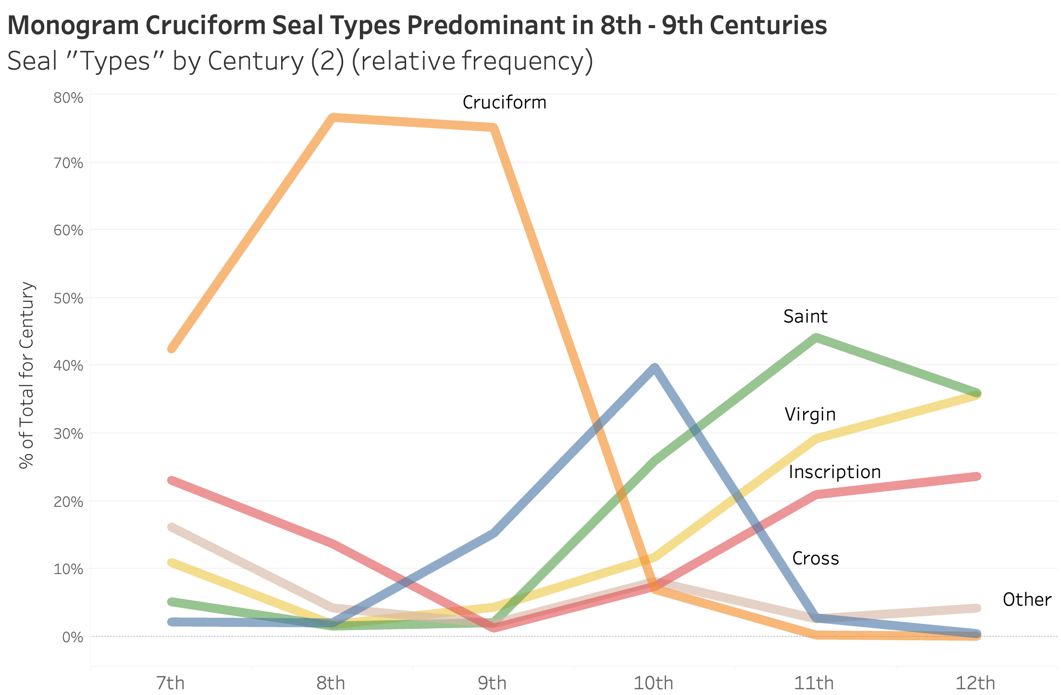

Slide 7
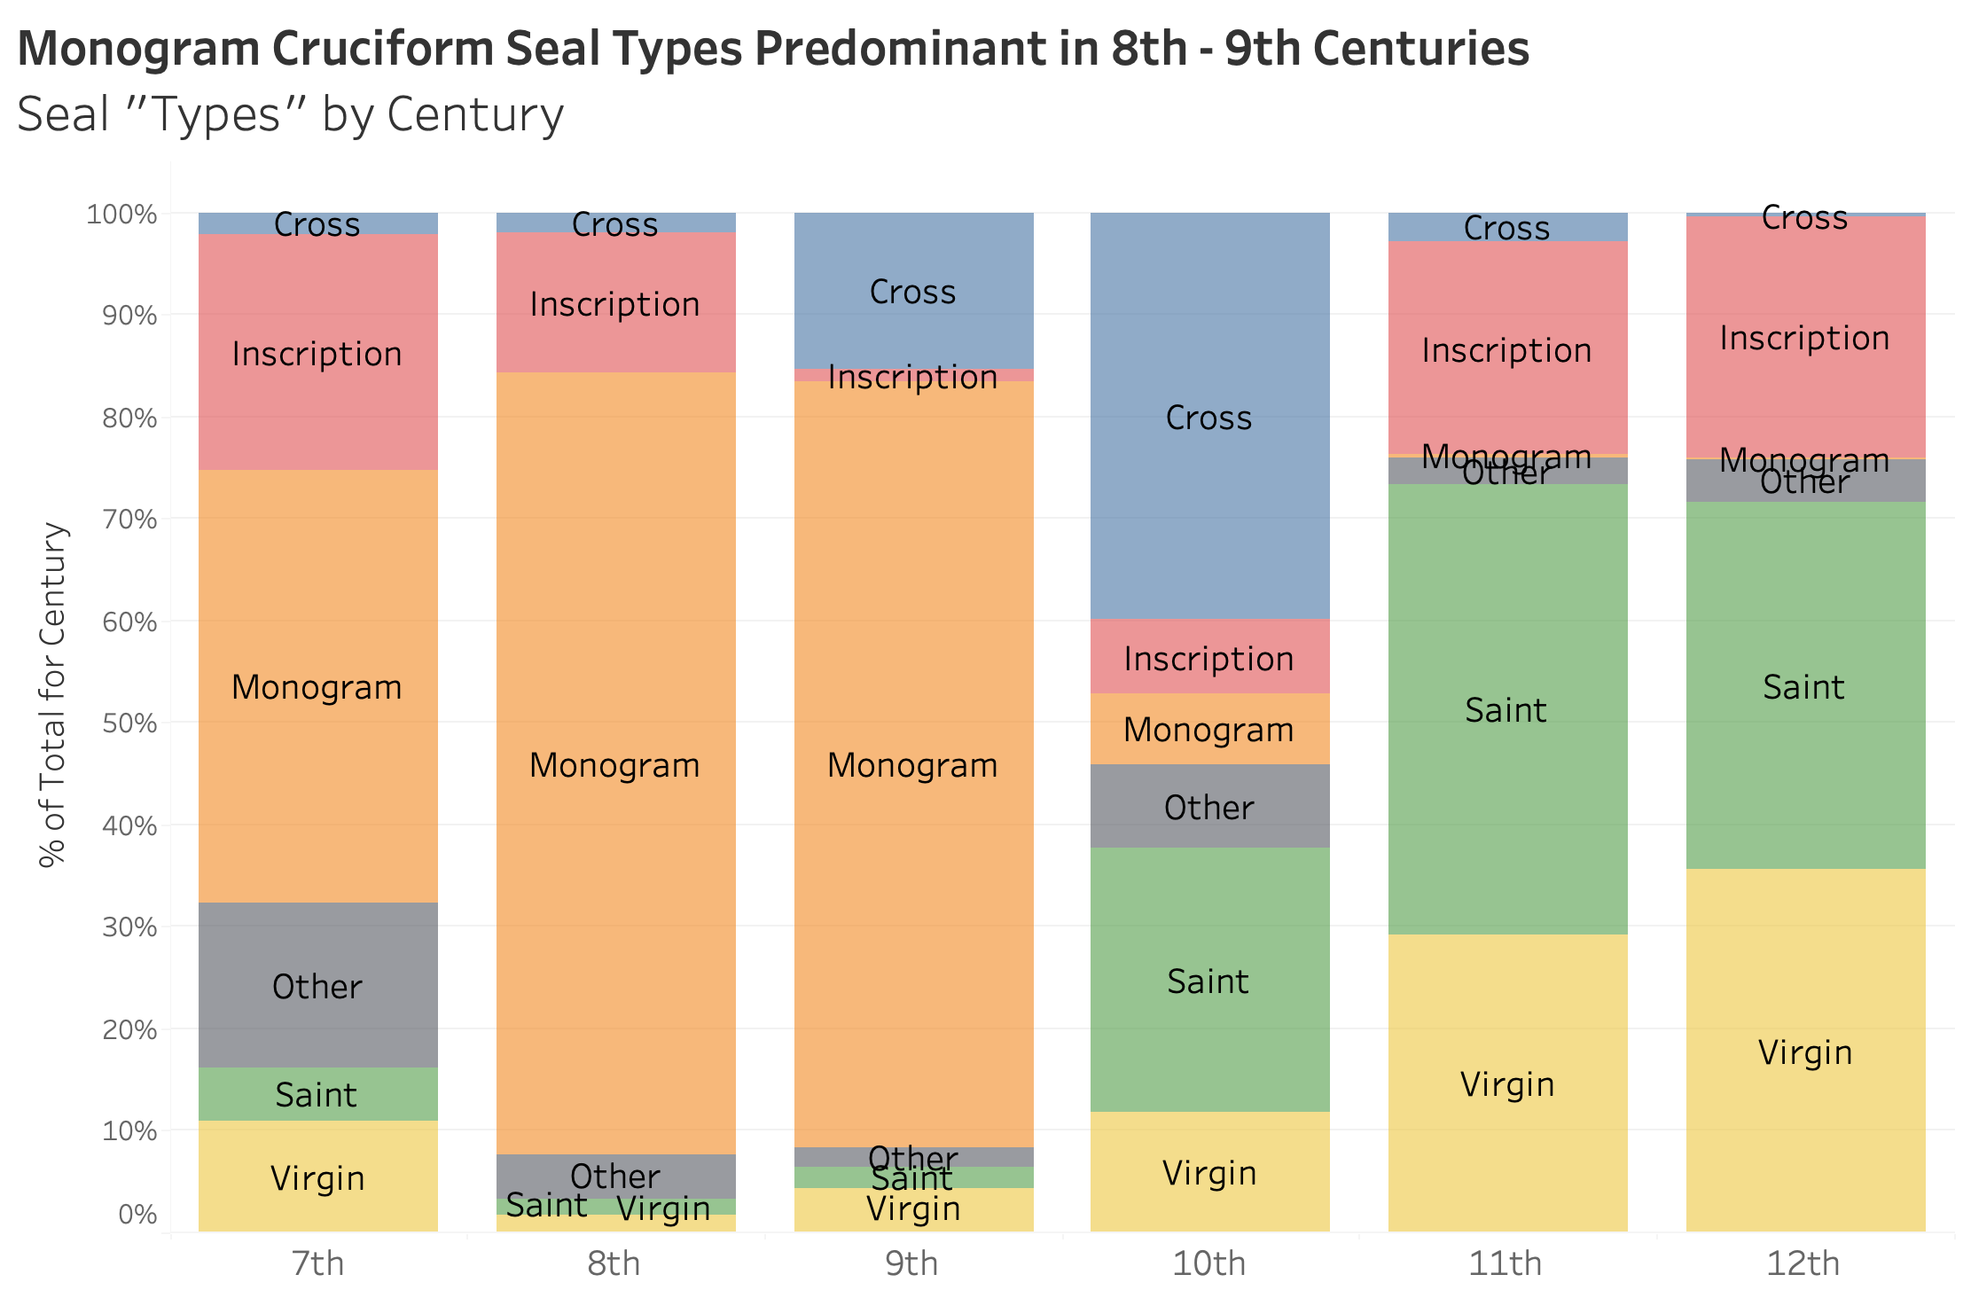

Slide 8
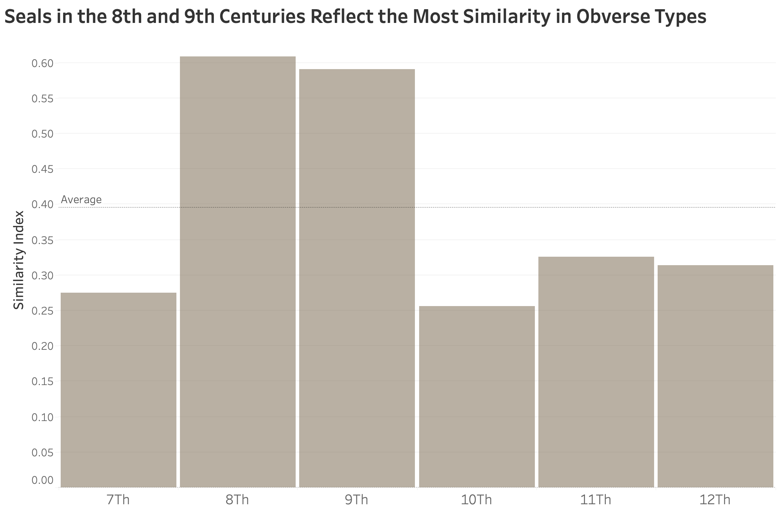
60% likely to pull same type as last draw
25% likely to pull same type as last draw

Slide 9
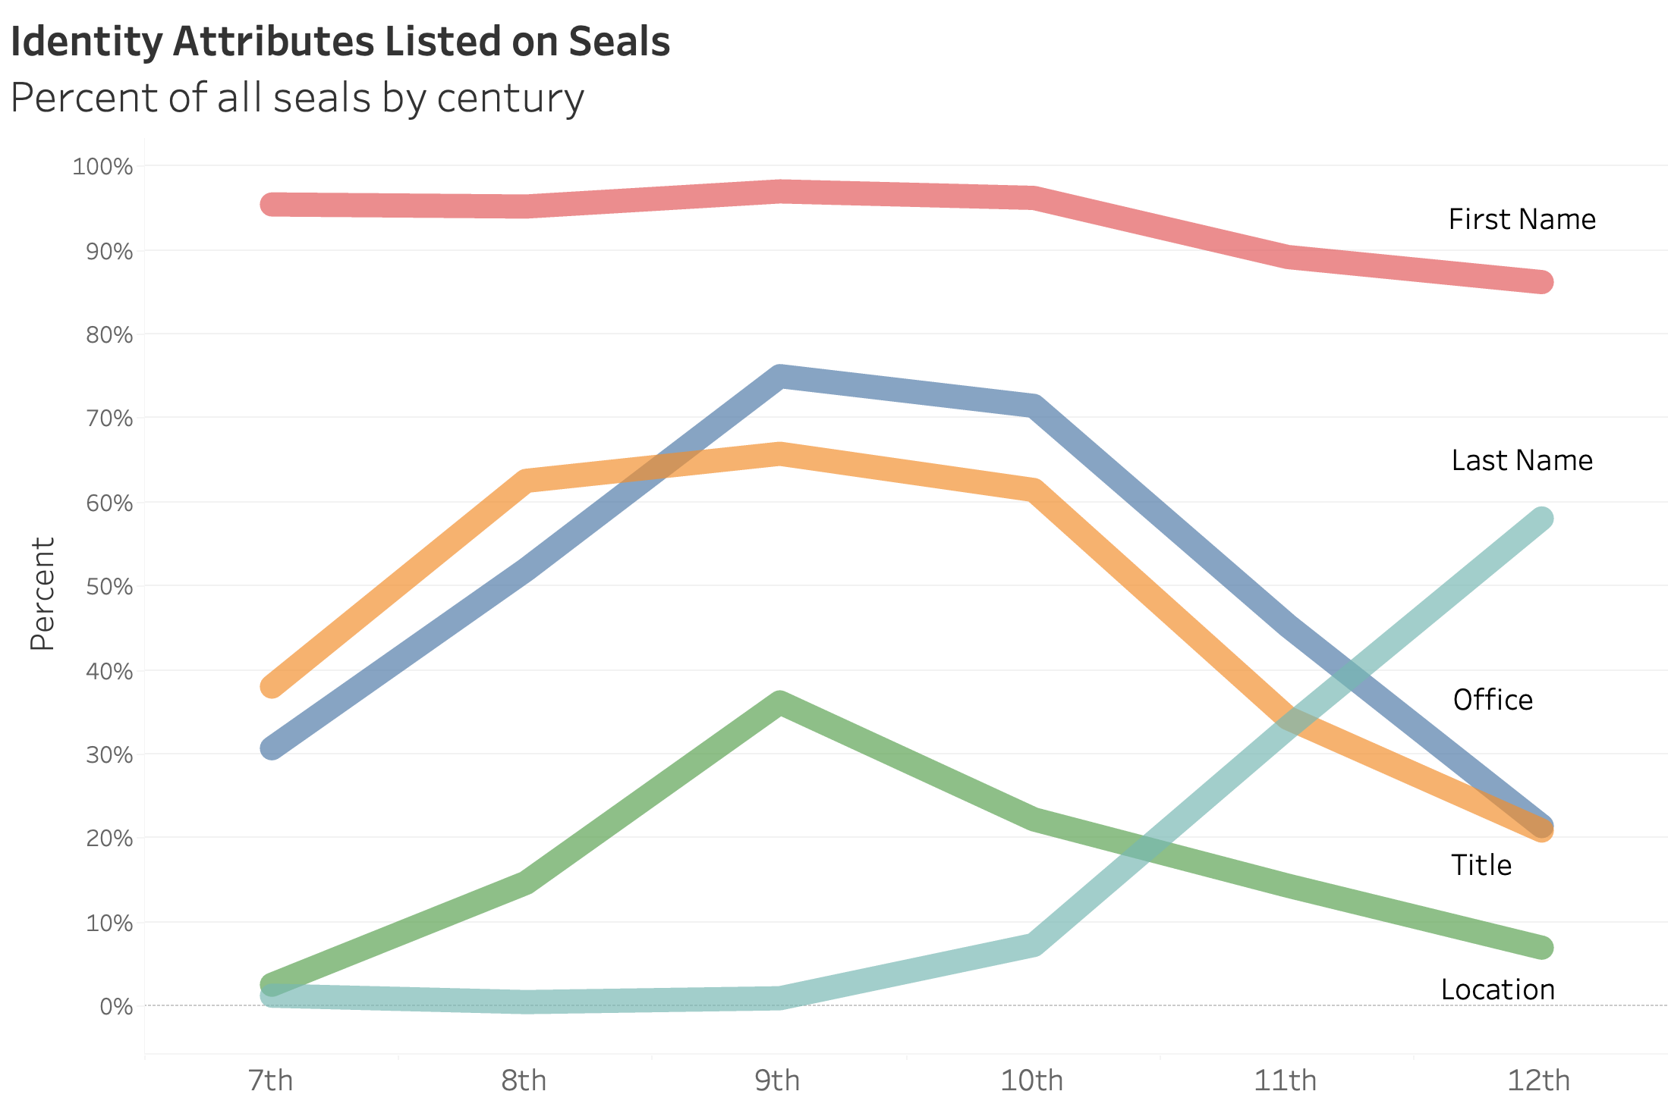

Slide 10
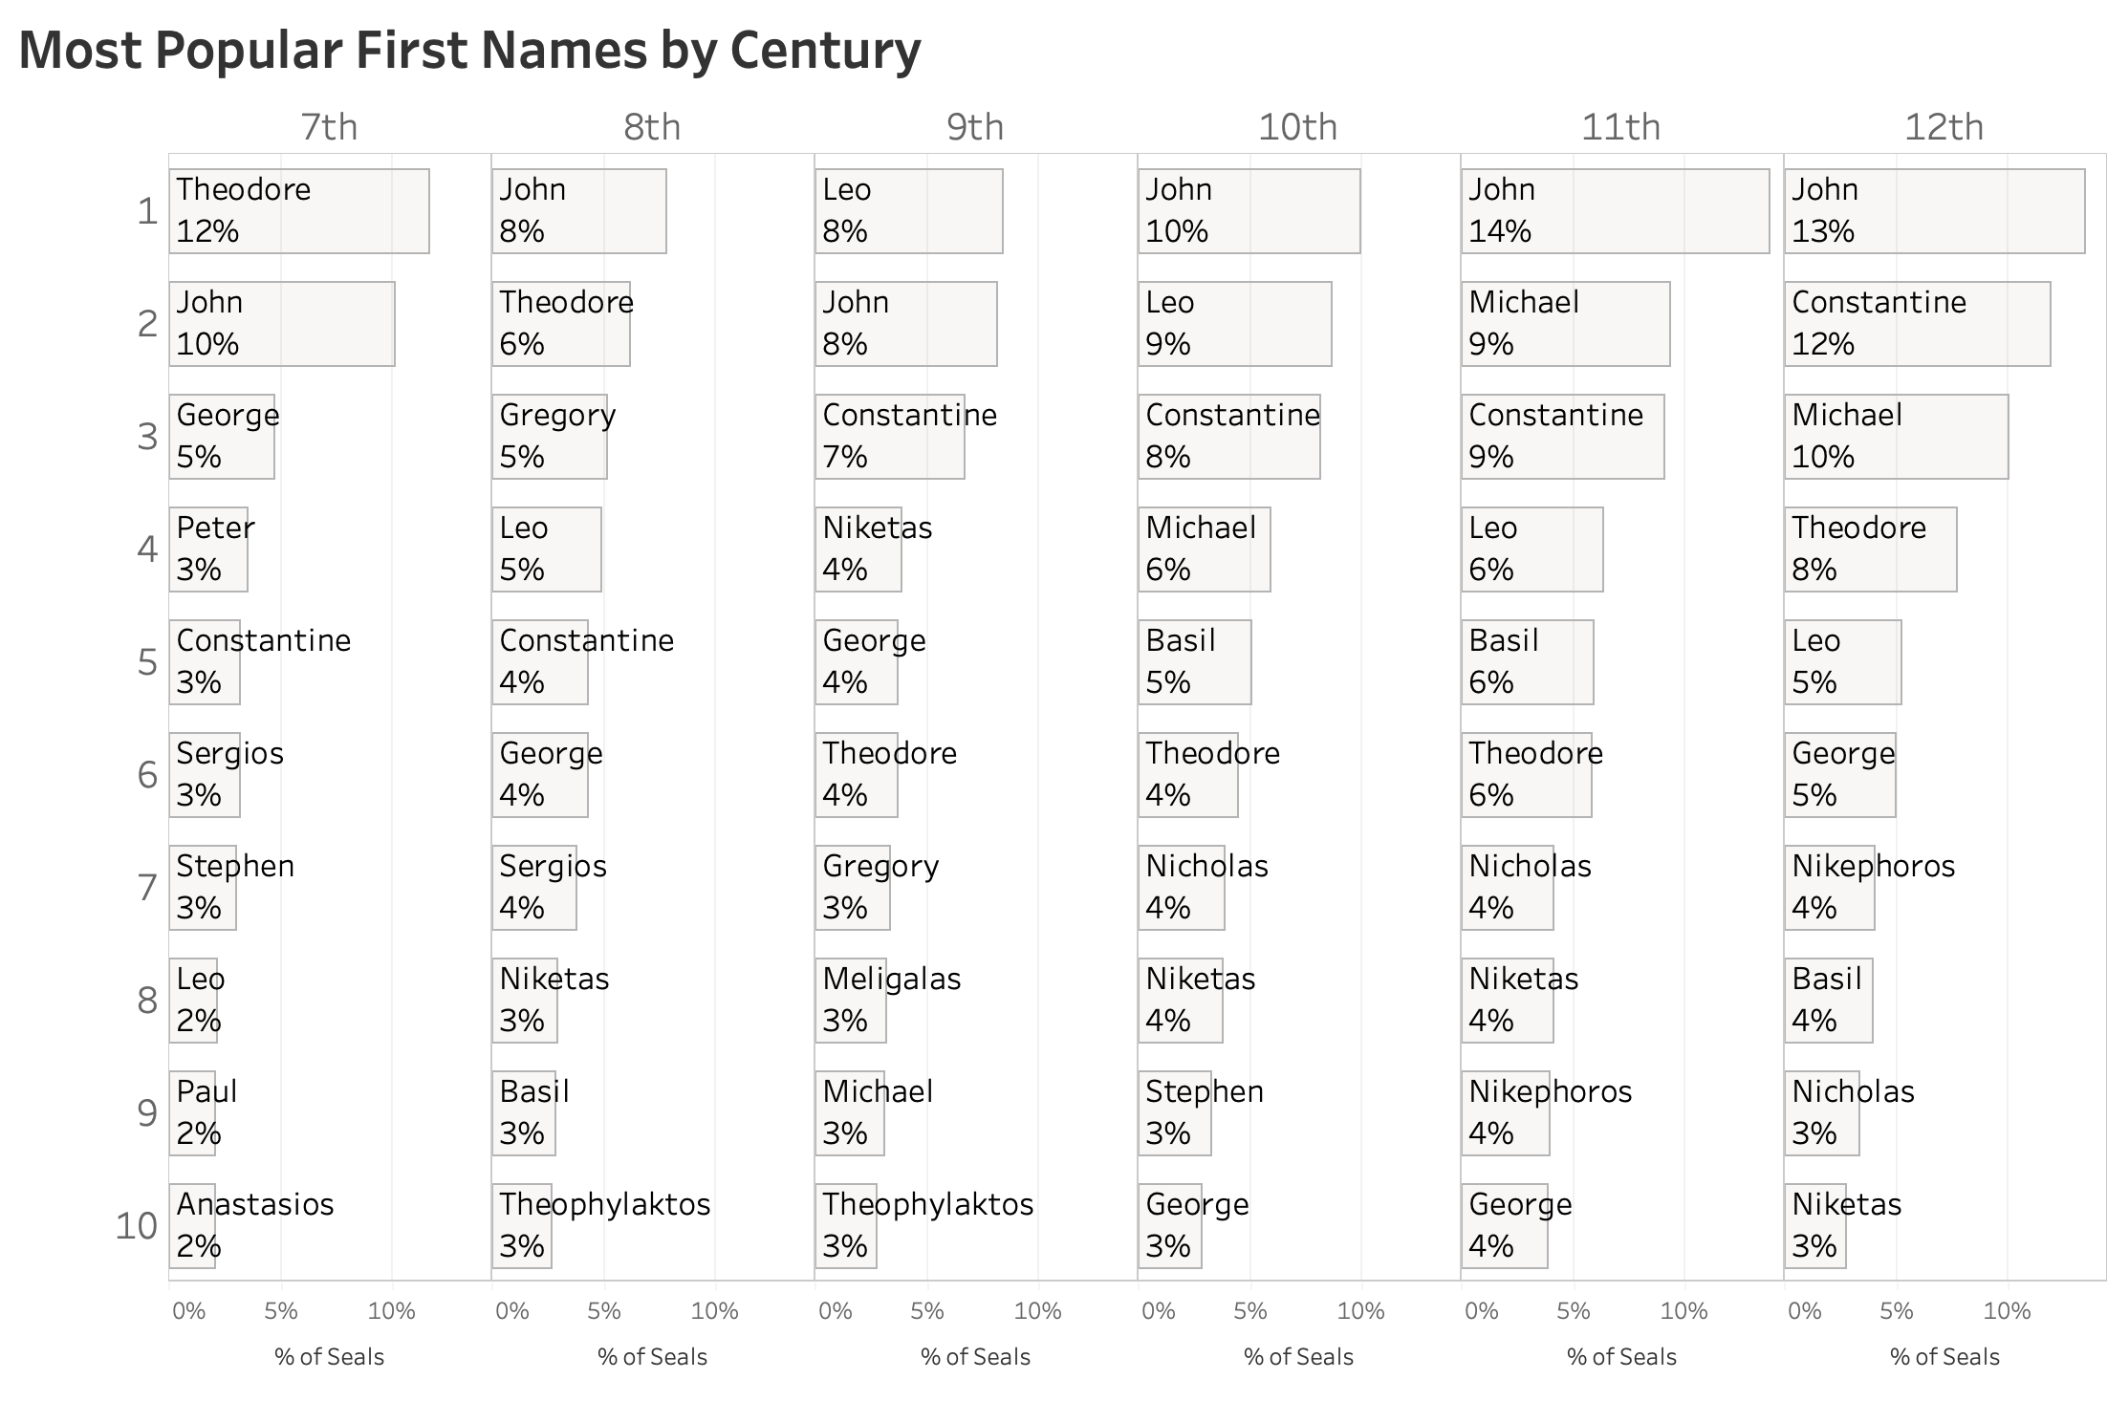

Slide 11
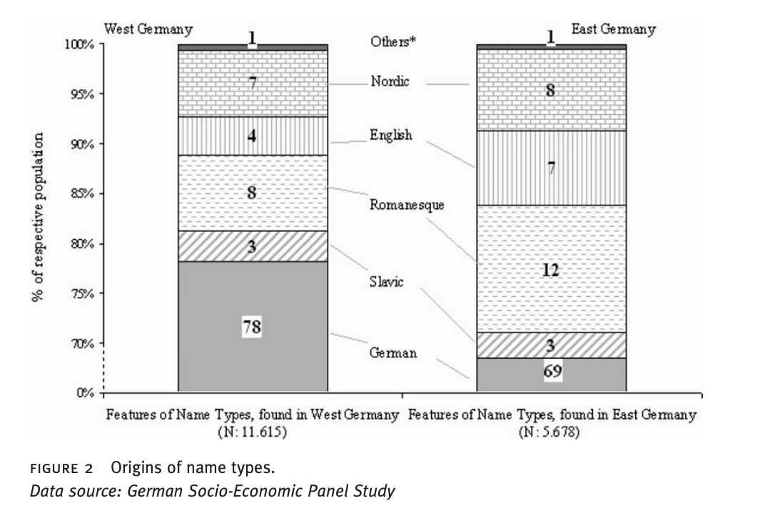
East Germans Favored English Names More than West Germans!
Naming Differences in Divided Germany
December 2009, Names: A Journal of Onomastics 57(4)

Slide 12
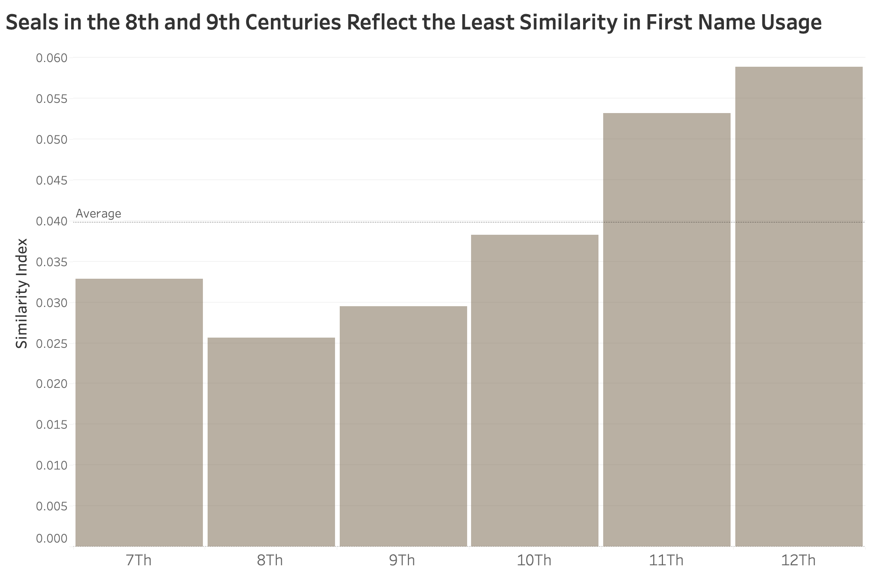

Slide 13
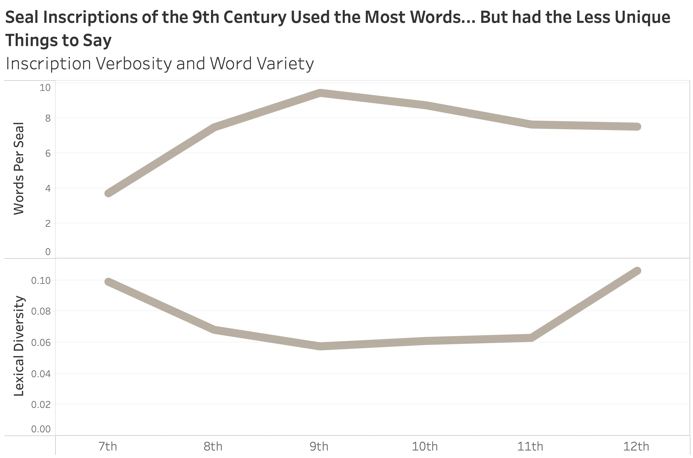

Slide 14
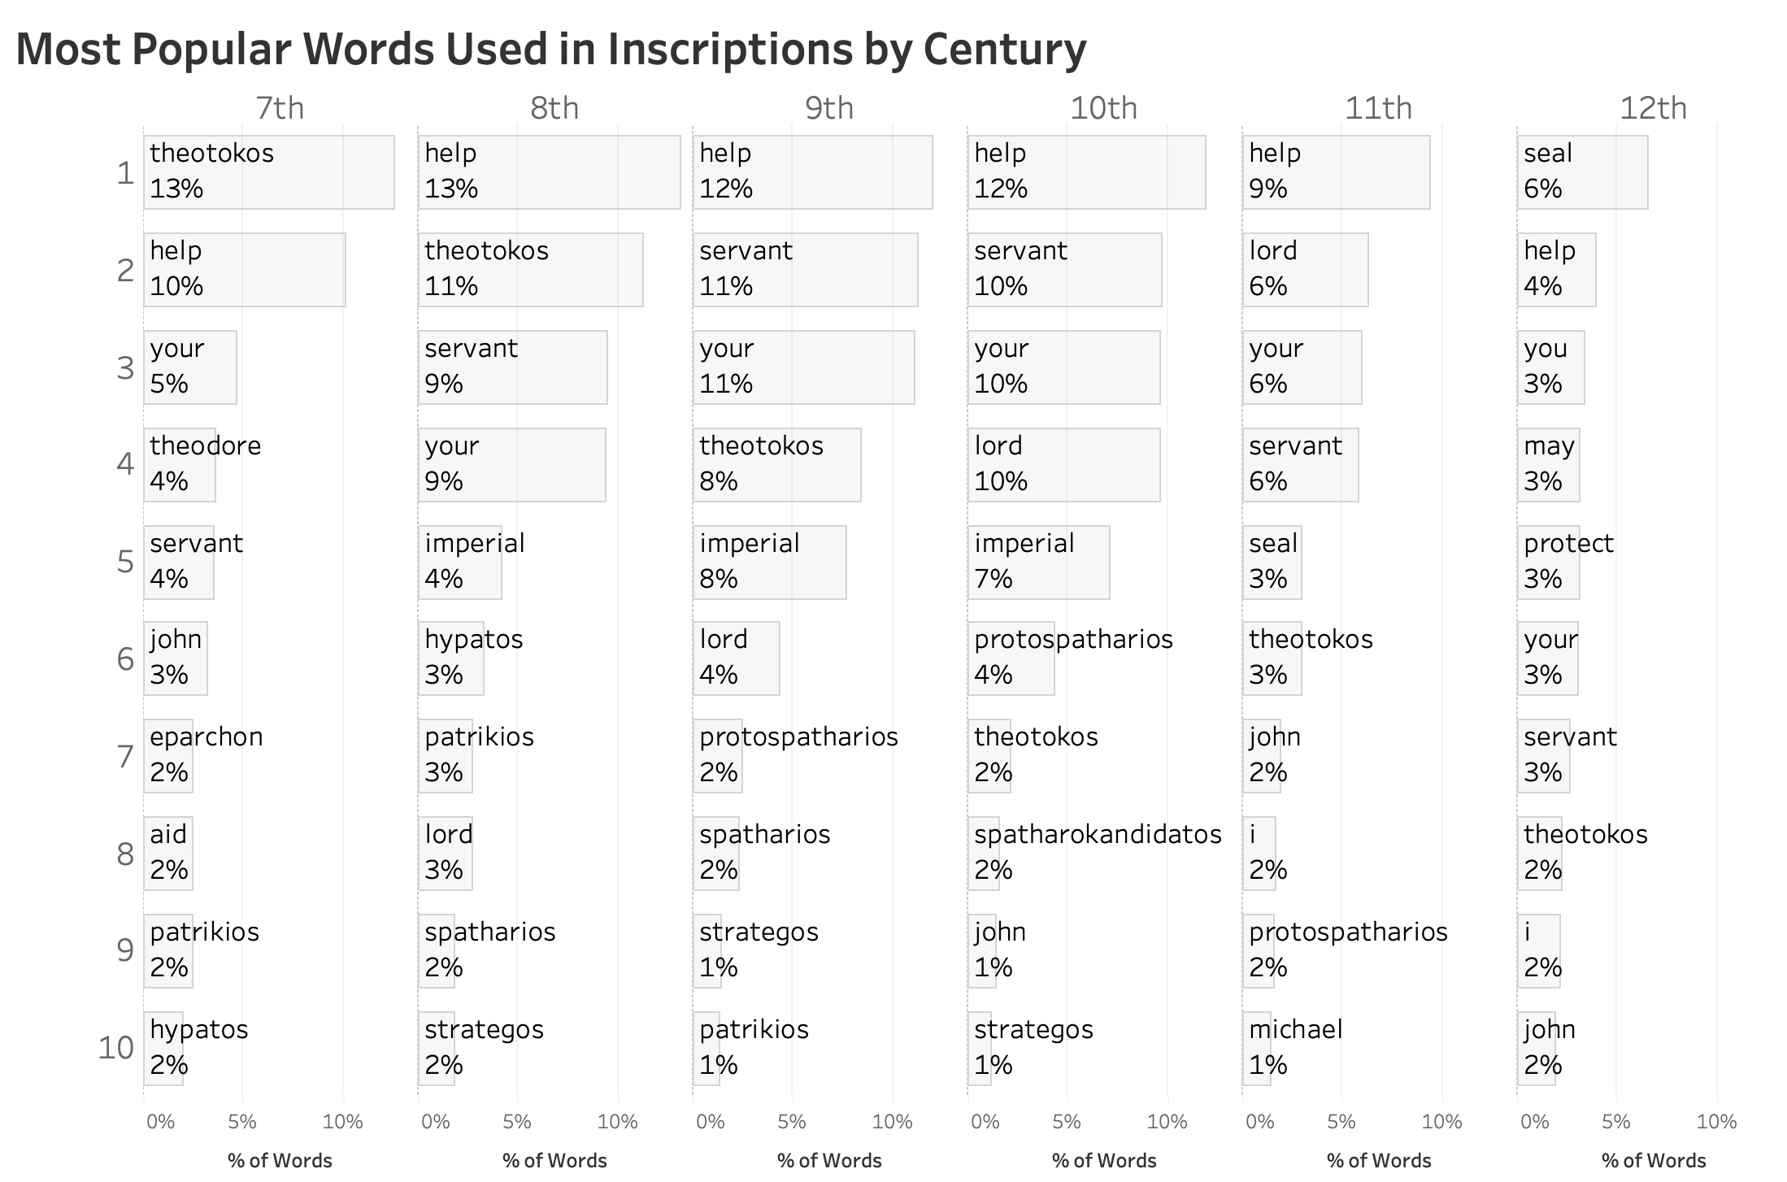

Slide 15
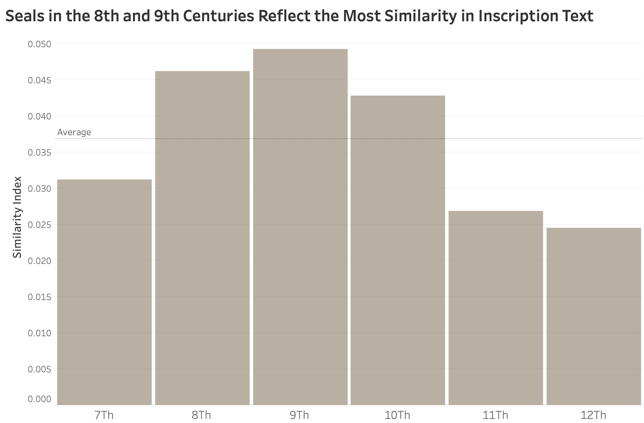

Slide 16
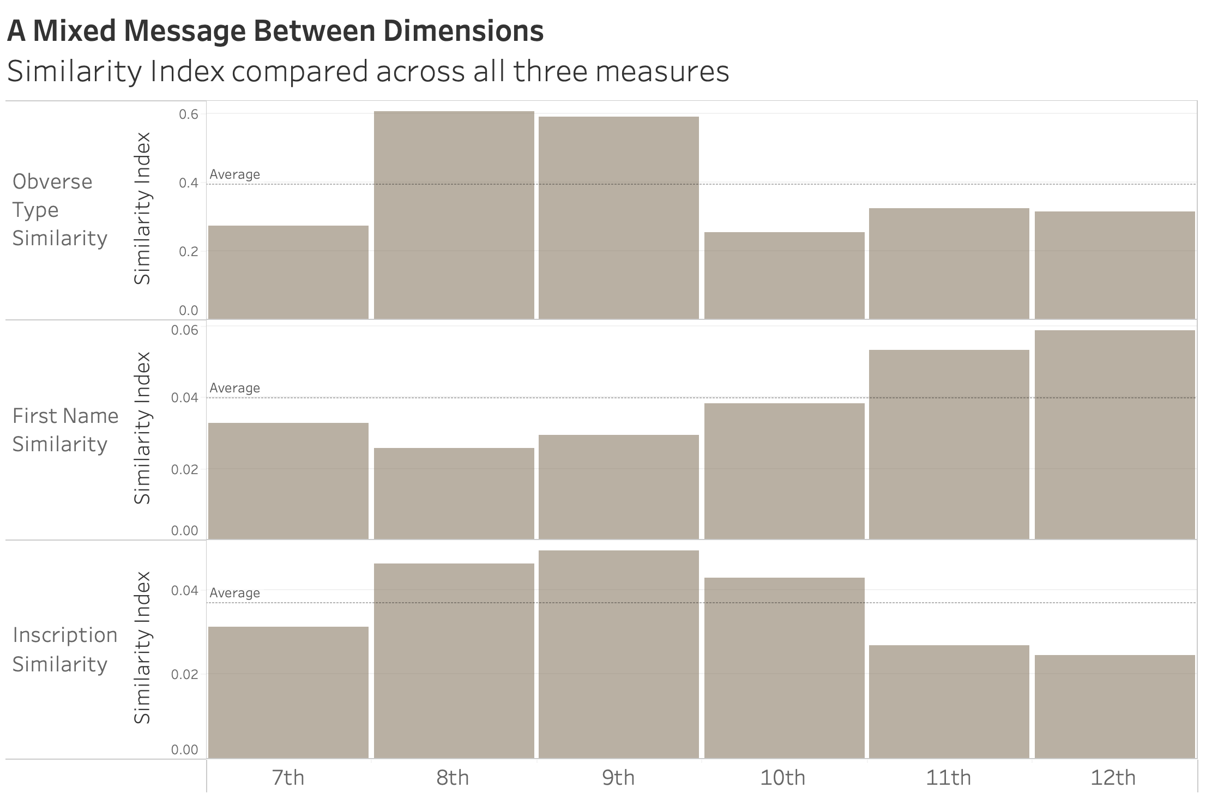

Slide 17
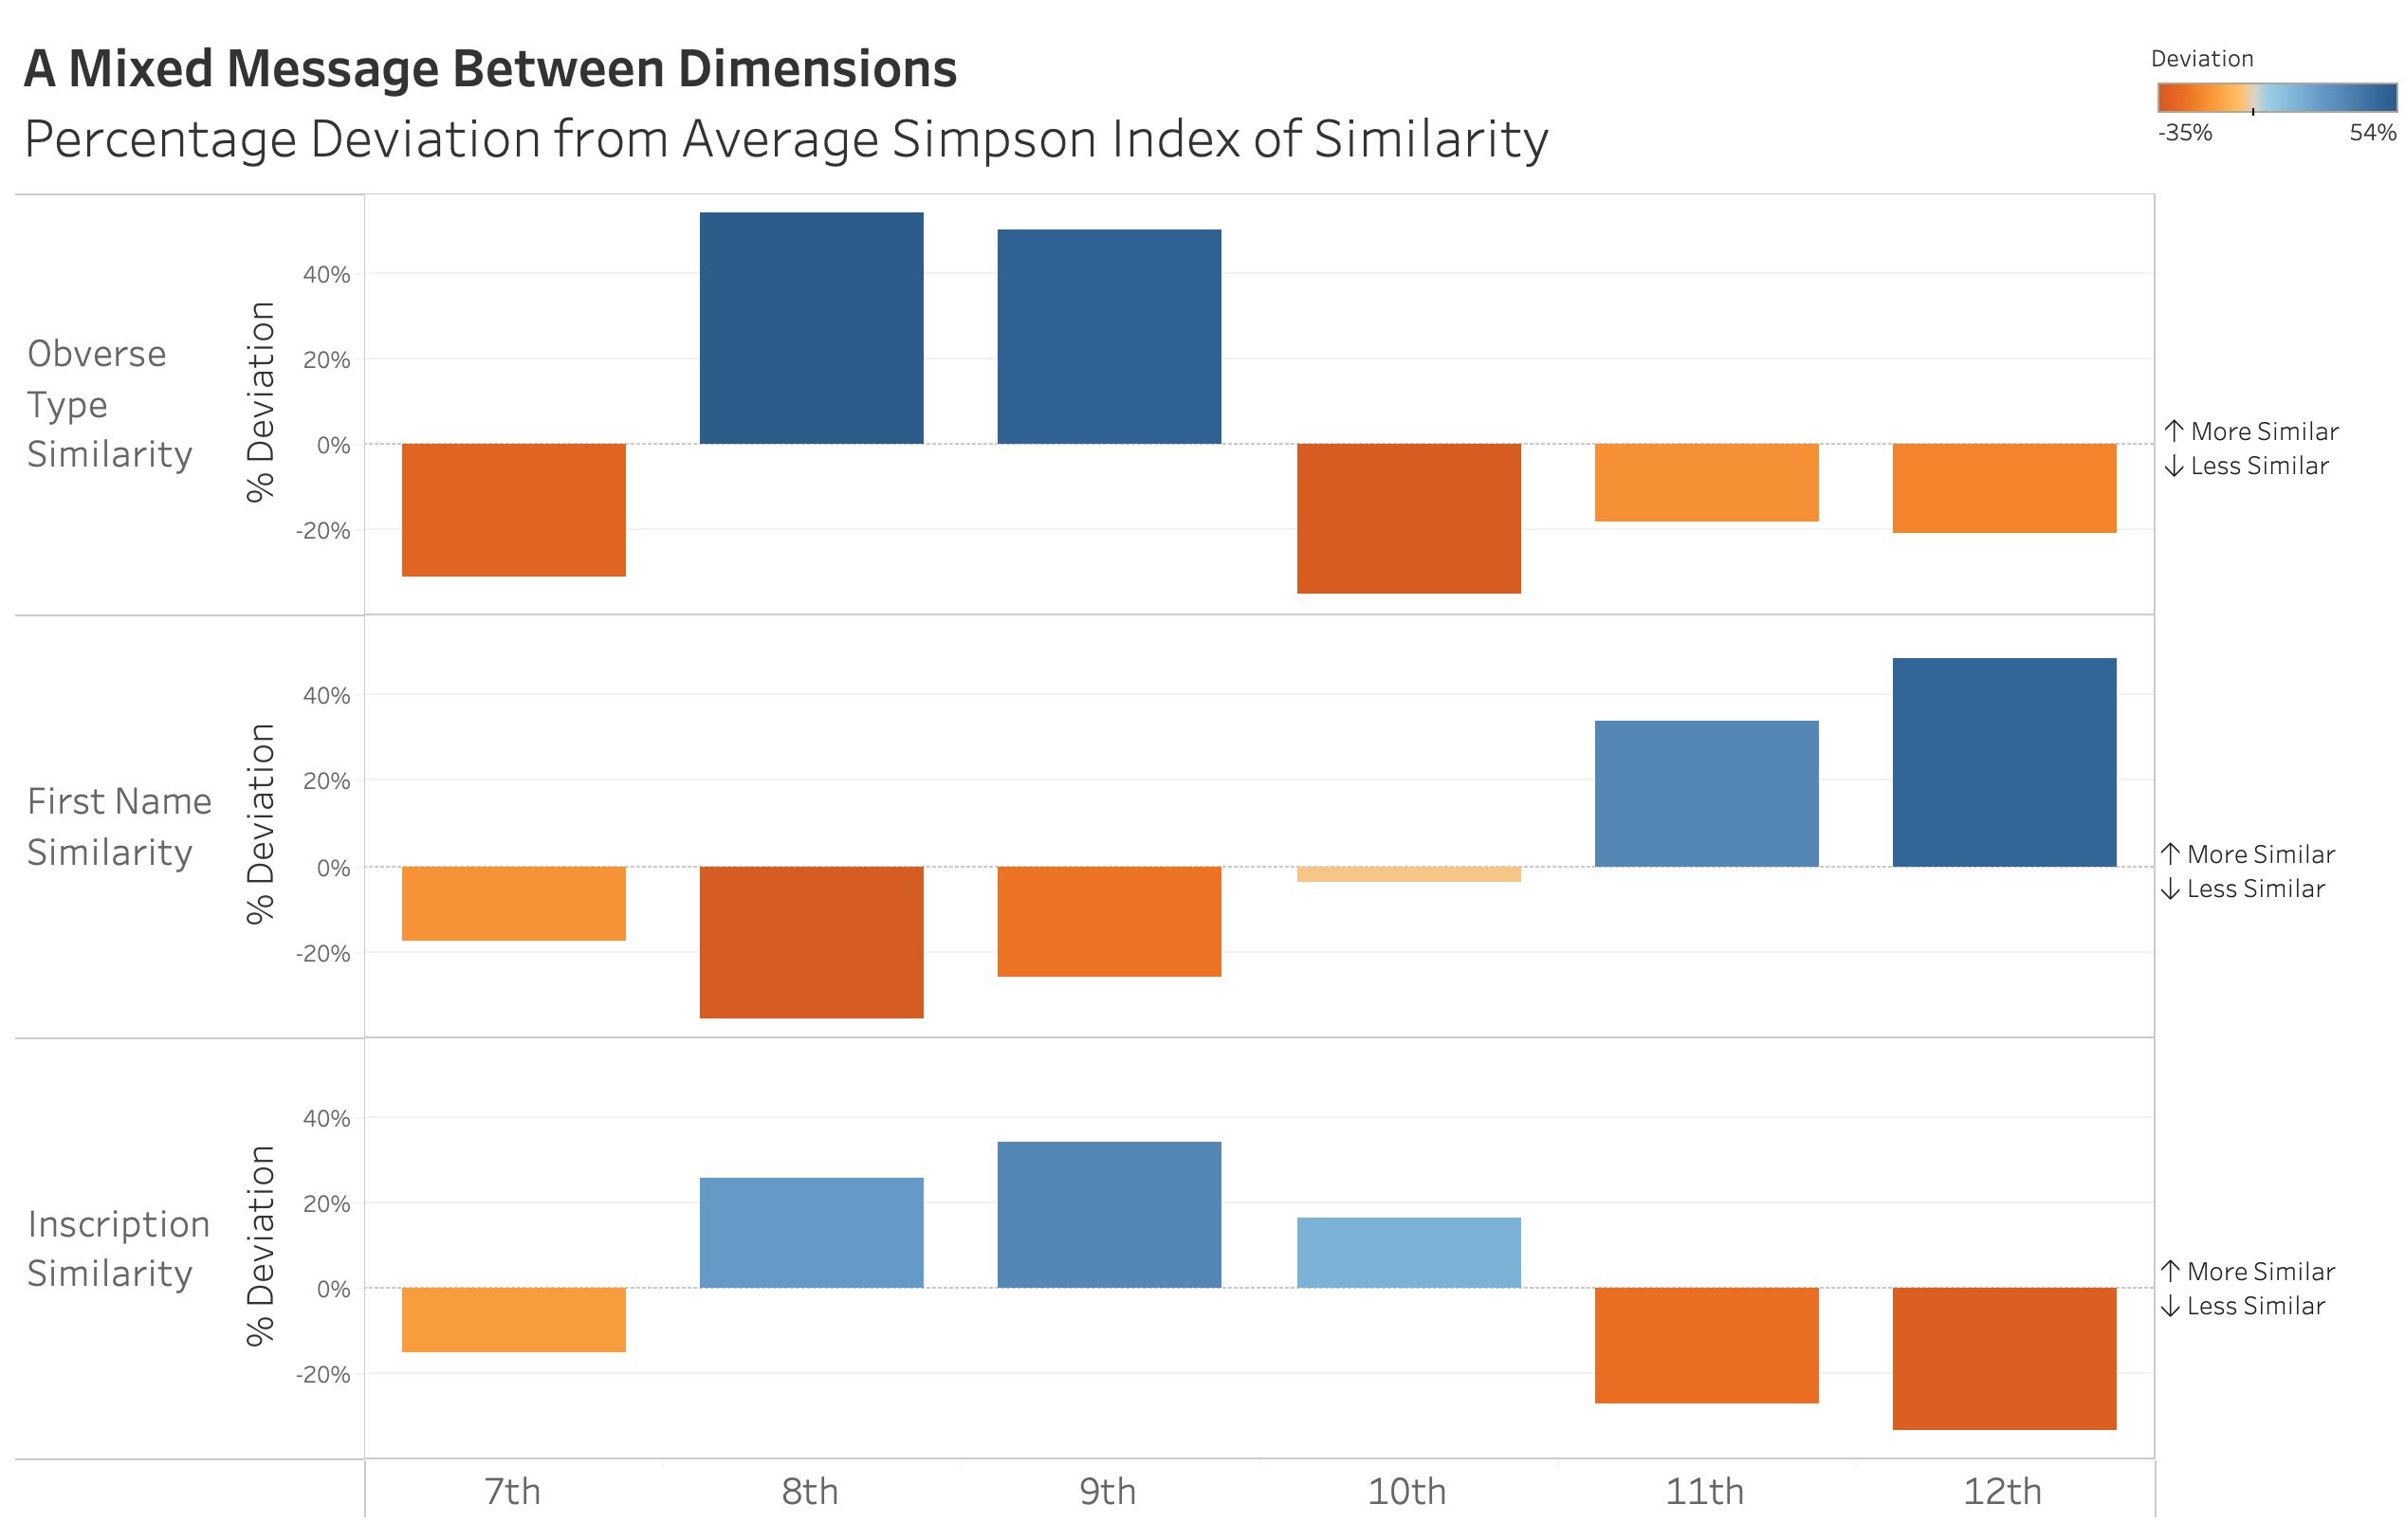
Notes:
In this graph, blue bars falling above the line indicate instances when a century showed more similarity than the average, and orange bars falling below the lines indicate less similarity. For those looking for easy conclusions, the data is not fully obliging. We see, in general, when Type and Inscription Similarity go up, First Name Similarity tends to go down and vice versa.
To me, this is really surprising. Intuitively, one would expect all of these similarity measures to agree. Seal Type, First Name, and Inscription Verbiage all seem to be valid markers for overall cultural conformity or diversity.
Honestly, my first instinct was to question the relative validity of each dimension. Perhaps one is somehow better than the others in reflecting the overall culture?
However, in thinking through this puzzle, I now realize I started my project with a basic misunderstanding of the nature of culture. I began with the implicit assumption that a culture could be characterized as more or less relatively overall conformist. To my chagrin, I now understand that this assumption is actually just an example of the logical fallacy of reification.
Instead, I would suggest that culture is in fact an abstraction, something that emerges from the interactions of its individual members. Even more, when we look at these individuals, I propose that it is intrinsic to human nature that while people want to fit in, they also paradoxically seek to stand out. Considered together, these propositions make it inevitable, that, in any culture, we would simultaneously find both relatively higher conformity and relatively higher diversity across different dimensions.
This is exactly what this project has found and what this slide shows. Here it is staring at our faces.
I now realize that, because of its very nature, one cannot characterize any culture as being more overall conformist or diverse. Because I wasn’t expecting this conclusion, this is an insight I particularly value.
On top of being unexpected, this realization also serves as a reminder that when we investigate history using a computational lens, we can get new types of insights and questions other approaches might not readily afford.
What I hope you all have gotten out of this talk is not only a shared appreciation of this insight into the nature of culture but also an appreciation of the value of using a computational lens to explore some of the rich things we can learn from Byzantine seals. [SLIDE]

Slide 18


Questions/Comments/Data
palbert2@gmu.edu
Data :
bit.ly/SealsSayWhat
Special thanks to Jonathan Shea for invaluable feedback on this project!
All errors are solely my own.

Slide 20
One more thing!

Slide 21
